Slide 1
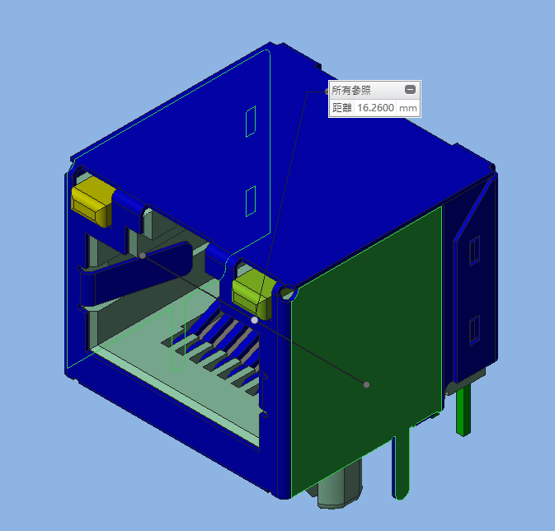
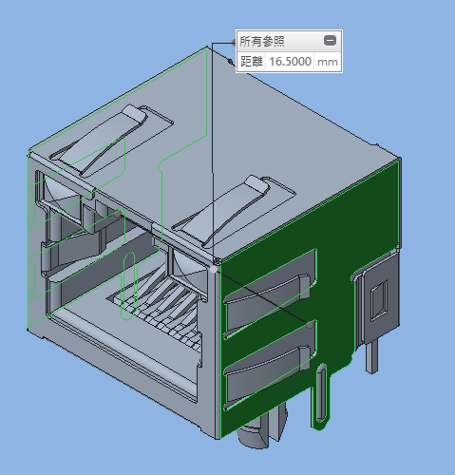
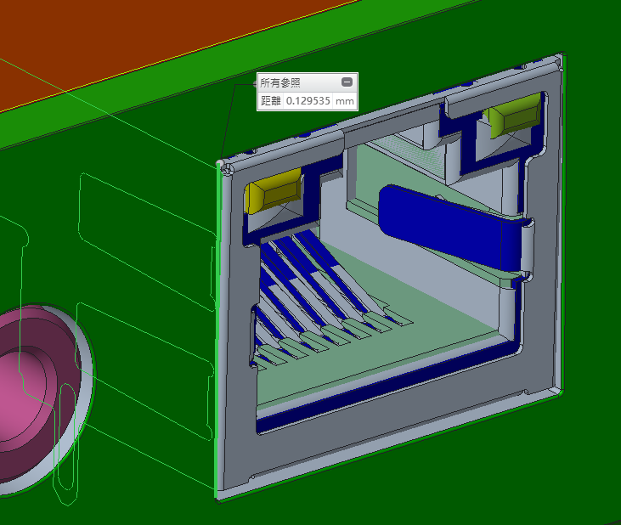
Connector Components
Item | Original Part | Original Part |  |  | Alternative Part |  | Consideration Point
 | Part Name | Manufacture | Part reference | Quantity | Part Name | Manufacture
RJ-45 Connector | JMP1N01-RA117-4F | Foxconn | J801 | 1 | 10221188C098 | CNS
Fii Reply:
1. The width of CNS one is slightly larger than main source (16.5mm vs 16.26mm), only have 0.12mm gap with housing if using CNS connector, might have interference issue.
Main source
10221188C097

Slide 2
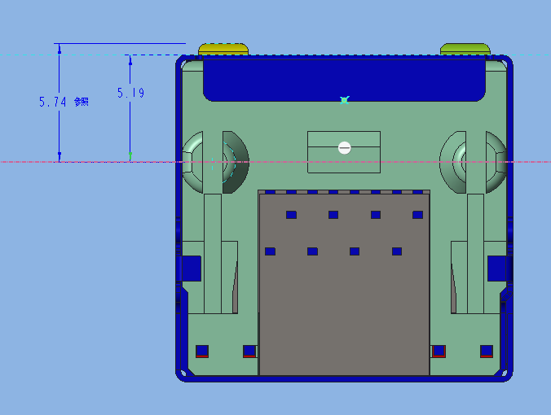
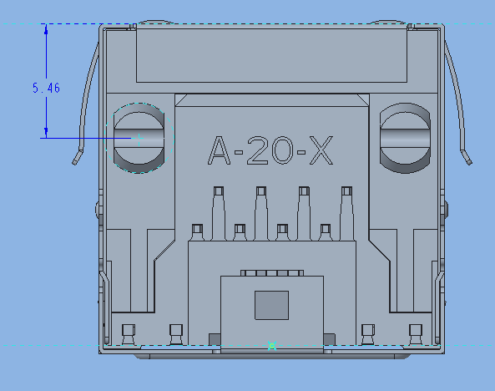
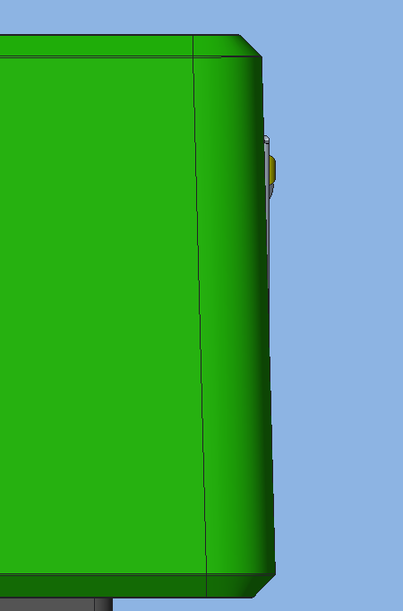
Connector Components
Fii Reply:
2. The dimension of CNS connector between positioning pin and front surface (LED side) is larger than main source, which will have flatness issue at back panel after assembly.
Main source
10221188C097

Slide 3
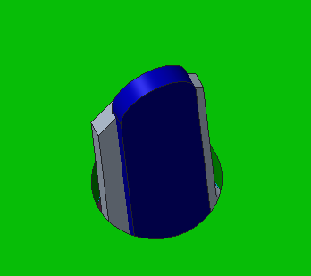
Connector Components
Fii Reply:
3. The dimension of soldering pin on CNS connector is larger than main source, which might be hard for insertion during PTH process.
10221188C097
Main source

Slide 4
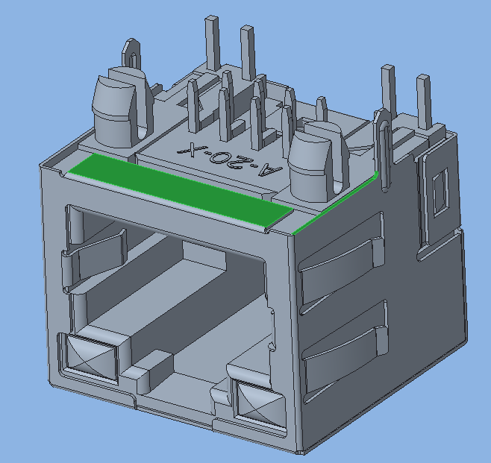
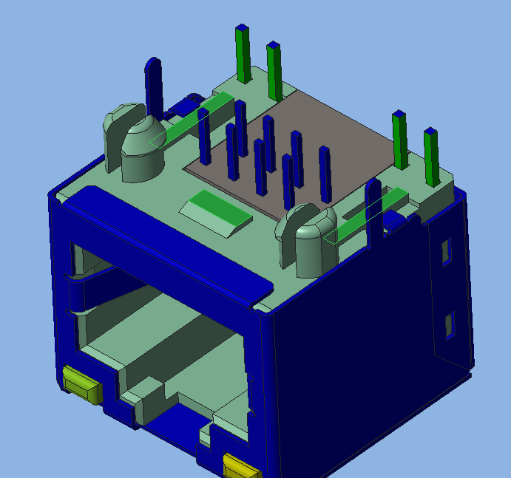
Connector Components
Fii Reply:
4. The structure of the connectors are different which there are protrusions at bottom side of main source, which might cause the height is different after put onto the PCB.
protrusions

